Slide 1
What are Atoms, Elements and Compounds?

Slide 2
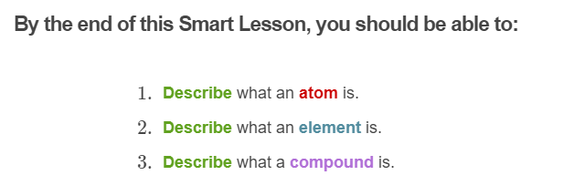
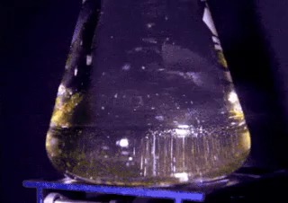

Slide 3
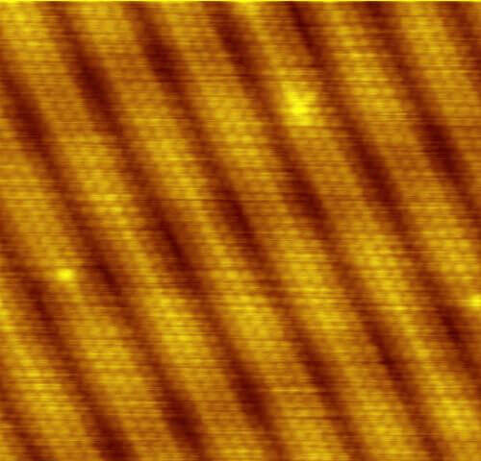
Atoms are the basic building block of all matter.
They are so tiny that they cannot be seen except with a powerful microscope called a scanning tunnelling microscope (STM).

Slide 4


Slide 5
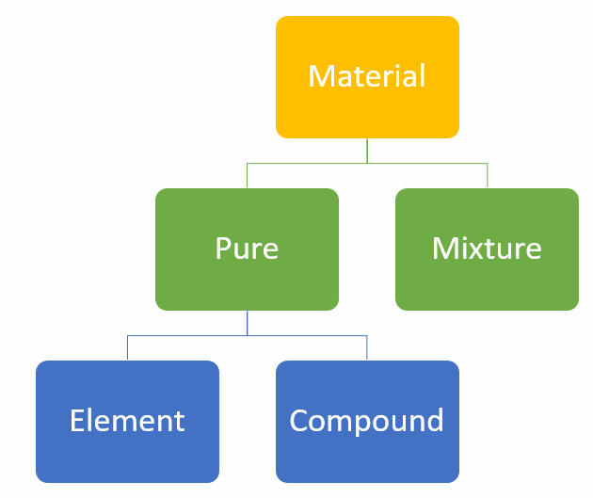
Atoms can combine in different ways to produce different types of substances.
The types of substances you need to know about are elements and compounds.

Slide 6
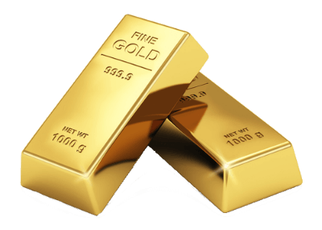
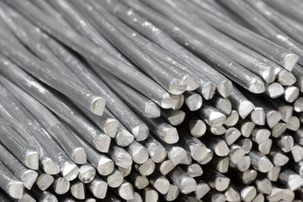
An element is a substance that contains only one type of atom.
For example, a lump of pure gold metal contains only atoms of gold, and a lump of aluminium metal contains only atoms of aluminium.

Slide 7
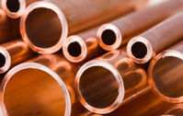
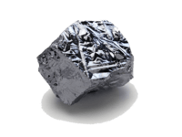
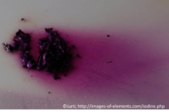
Elements can be metals, non-metals, or metalloids.
These different types of elements have different properties, which are determined by the type of atoms that make them up.

Slide 8
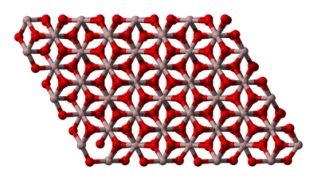
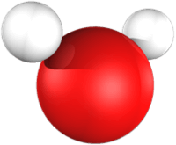
Atoms can also form chemical bonds with other types of atoms to form compounds.
Compounds can be molecules or lattices, and they always contain at least two different types of atoms.
Molecules are made up of non-metal atoms chemically bonded together, such as water (H₂​O). Lattices are large grid-like structures made up of ions chemically bonded together, such as aluminium oxide (Al_{2​}O₃​).

Slide 9
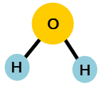

Both molecules and lattices can also contain just one type of atom.
Oxygen forms molecules of O₂​, and diamond is made from lattices of carbon on its own.
But in this case, neither oxygen molecules nor diamonds are compounds. Compounds always contain at least two different types of atoms.
Oxygen: A molecule, but not a compound!
Water: A molecule and a compound, because it has both hydrogen and oxygen atoms.

Slide 10
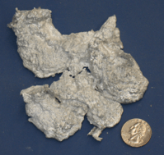
The properties of compounds are very different from the properties of the elements that make them up.
For example, aluminium oxide is a white crystalline solid, while elemental aluminium exists as a silver coloured metal and oxygen exists as a colourless gas.

